Slide 1
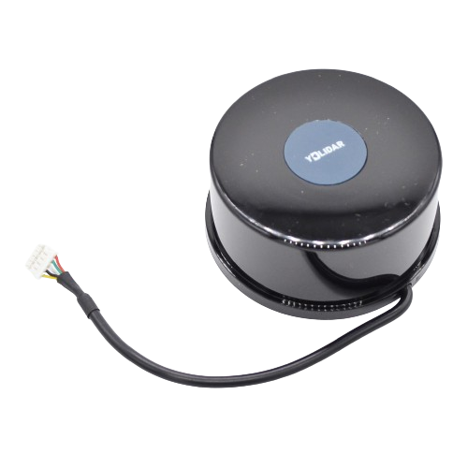

YD LiDAR TG30
Description
YDLIDAR TG30 is a 2D LiDAR.
Based on the principle of ToF (Time of Flight).
It is equipped with related optics, electricity, and algorithm design to achieve high-frequency and high-precision distance measurements.
The mechanical structure rotates 360 degrees to obtain the angle information and output continuously the point cloud data of the scanning environment while ranging.
Specifications
Operating Voltage - 4.8V to 5.2V (Default 5V)
Detection Range - 40m
Scanning Angle - 360 deg
Scanning Frequency - 5 to 12 Hz
Applications
Robot Navigation and Obstacle Avoidance
Smart Transportation
Environmental Scanning and 3D reconstruction
Robot ROS teaching and research
Official Website : https://www.ydlidar.com/service_support.html
Notes:
Keep Market Segments Change Names
Electrification >>>> Powertrain

Slide 2

Parts Required
USB Type C cable
USB Adapter Board
Read User Manual Carefully
Use Appropriate Software & Versions of ROS
Don’t use unauthorized spare parts, cables, and accessories
Don’t mount it on uneven surface
Notes:
Keep Market Segments Change Names
Electrification >>>> Powertrain

